Slide 1
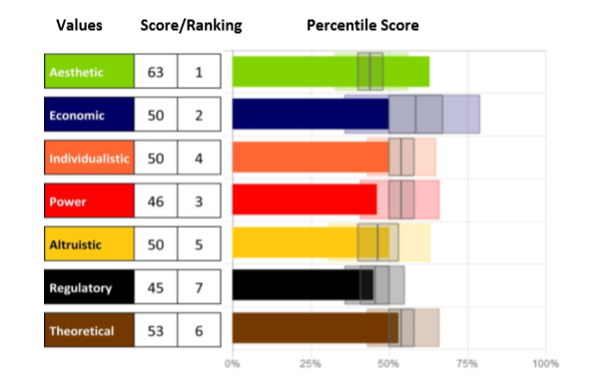
Motivators Understanding What Moves Us
Notes:
Research shows that the most successful people share the common trait of self-awareness. They’re able to more quickly recognize situations that will make them more successful. As such, it’s easier for them to find ways of achieving objectives that resonate and align with their motivations. They understand their limitations and where those situations in which they’re not as effective. They’re able to anticipate what will not inspire them or motivate them to succeed. Those who understand their natural motivators better are far more likely to pursue the right opportunities, for the right reasons, and get the results they desire.
Our hope is that at the end of our time today, you’ll have a more comprehensive knowledge of your preferences, your motivations, and your drivers to determine how to effectively reach for your own satisfaction and success.

Slide 2
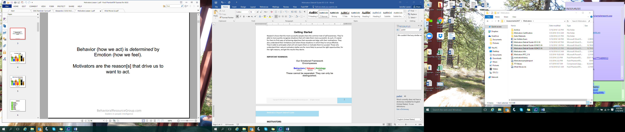
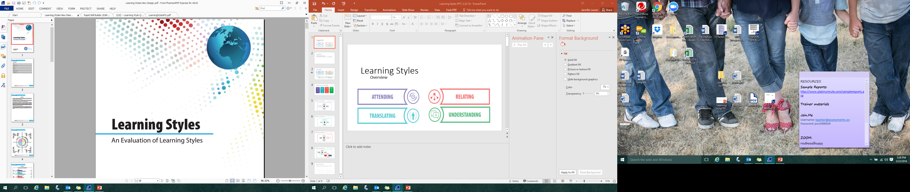
Behavior and Motivators
©2016 Assessments 24X7
Notes:
People see the world differently; we all have our own biases. We all have our own desires, and we all express those views and desires through our actions.
Behavior is how we act. It is determined by our emotions – how we feel.
Motivators are the why behind those emotions –Understanding our motivation reveals why we prefer to do what we do.
Motivators reveal our viewpoint, our mindset, our paradigm of thought, our way of judging and valuing life. They are the reasons that drive us to WANT to act.
**Keep in mind, we may act differently than we want to for a variety of reasons.

Slide 3
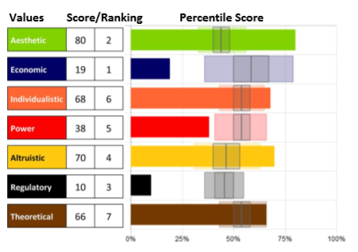
Motivators Overview
Motivators
Filter and guide decisions specifically toward results that reflect them
Combine uniquely for each person to influence individual priorities and decision-making
Help people to better understand their unique value or belief system
Notes:
Motivators help people to better understand their unique value hierarchy or belief system pertaining to what motivates them, what they are most drawn to and where their passions lie.
There are many benefits of learning what Motivators influence us.
The Motivators filter and guide decisions specifically toward results that will reflect them; they combine uniquely for each person to influence individual priorities and decision-making. It is vital for optimal performance that our motivations are satisfied by what we do. They drive our passions, reduce fatigue, and inspire us.

Slide 4

Importance & Impact
Importance – IF I value it and HOW I value it (determined by high or low scores)
Impact – how it influences my decisions & actions (determined by distance from norm – the ranking)
Notes:
Both of these concepts are incredibly important in Motivators. While connected, there are different concepts to consider when reviewing the Motivators.
IMPORTANCE is determined by the score and comes in two parts – it explains IF I value the dimension and HOW I value it.
Let’s look at IF I value it first – A High Score means that the expression of this Motivator is very important to me. Example: If I am High Economic – getting a return on my investment is VERY Important.
A LOW Score means that this Motivators is not important to me. Example: If I am Low Economic, a return on my investment is NOT important to me.
Now, how I value it. My score (whether high or low) reveals a descriptor of HOW I value the dimension. (We’ll see these later on the word sketch). When we are looking at HOW I value it:
A High ECO score shows Competitive. This is HOW I interact with this Motivator or the “thing” that drives me.
A Low ECO score shows Satisfied. This is HOW I interact with this Motivator or the “thing” that drives me.
If I am driven by competition, then everything becomes an opportunity for me to fight for the win. If I am satisfied, I won’t fight for the win, but rather take what is presented to me as it comes and make the best of it.
IMPACT is how it influences my decisions and actions and is determined by distance from norm shown as a ranking. When exploring impact there are few things to know as well:
Impact is determined by how far your score is away from NORMAL. Scores that fall within the Average will have less impact because the needs are without passion, where scores that are higher or lower have more passion for or away from. Those in the middle could go either way, depending on the situation.
If Impact tells us how that Motivators will affect our decisions and actions, it’s helpful to remember some people are driven to be LIKE others, and some are driven to be DIFFERENT.
If 7 out of 10 people are all doing things the same way, the only person who will be noticed (and also feel out of place) will be the outlier, doing things in a way others haven’t.
Because all people are looking to balance an individual existence with a shared/community existence, being like the population can have a great deal of impact on how we choose to behave. If we don’t want to stand out, we may choose what would make us seem alike, rather than stand out.
We’ll talk more about these concepts again when we look at report scoring, but remember these are crucial to understanding how and why our Motivators drive us.

Slide 5
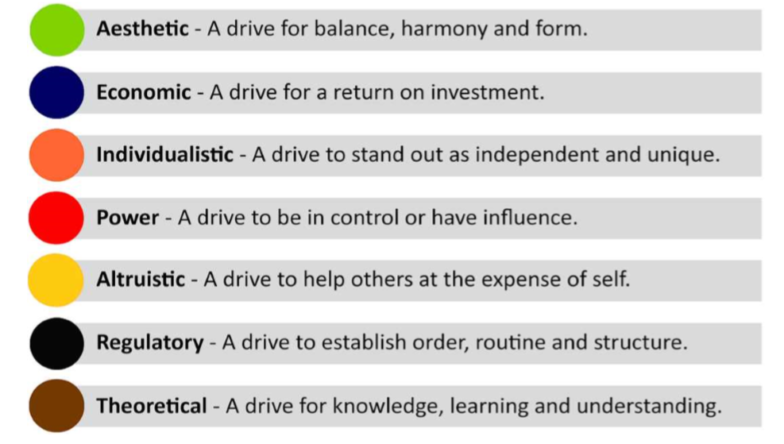
The Seven Dimensions of Motivation
Notes:
While it’s important to explore each motivator and what they mean, it is critical to remember that they cannot be separated. They can only be distinguished. Through an understanding of the motivators, we can begin to see how to maximize performance by achieving stronger alignment between our motivators, our choices, and our actions
The 7 Motivators:
Aesthetic - a drive for balance, harmony, and form
Economic - a drive for a return on investment
Individualistic - a drive to stand out as independent and unique
Power - a drive to be in control or have influence
Altruistic - a drive to help others at the expense of self
Regulatory - a drive to establish order, routine, and structure
Theoretical - a drive for knowledge, learning, and understanding

Slide 6
Aesthetic
Need
Want
Eccentric
Impractical
Unconventional
Divergent
Imaginative
Sensible
Realistic
Practical
Real World
Grounded
The Aesthetic Attractor: The main motivation in this driver is the strong desire and need to achieve equilibrium between the world around us and ourselves (within) while creating a sustainable work/life balance between the two.
Creative, alternative, imaginative, artsy, mystical and expressive, this style may redefine and resist real world approaches to current problems and challenges.
Very High
High
Average
Low
Very low
Notes:
Review Slide: Note animations to reveal definitions behind picture.
Start with scale visual, then click to share definitions
The main motivation in this driver is the strong desire and need to achieve equilibrium between the world around us and ourselves (within) while creating a sustainable work/life balance between the two.
Creative, imaginative, artsy, mystical, and expressive, this style may redefine and resist real world approaches to current challenges.

Slide 7

Notes:
What about this picture represents high Aesthetic?

Slide 8
Economic
Need
Want
Self-Mastered
Maximized
Competitive
Incentivized
Practical
Judicious
Relaxed
Aloof
Apathetic
Satisfied
The Economic Attractor: This attractor examines the motivation and drive for security through self-interest, and economic gain, and to achieve real-world returns on personal and professional ventures.
The preferred approach of this attractor is both a personal and a professional one with a focus on ultimate outcomes within each.
Very High
High
Average
Low
Very low
Notes:
Review Slide: Note animations to reveal definitions behind picture.
Start with scale visual, then click to share definitions
This attractor examines the motivation and drive for security through self-interest, and economic gain, and to achieve real-world returns on personal and professional ventures.
The preferred approach of this attractor is both a personal and a professional one with a focus on ultimate outcomes within each.

Slide 9
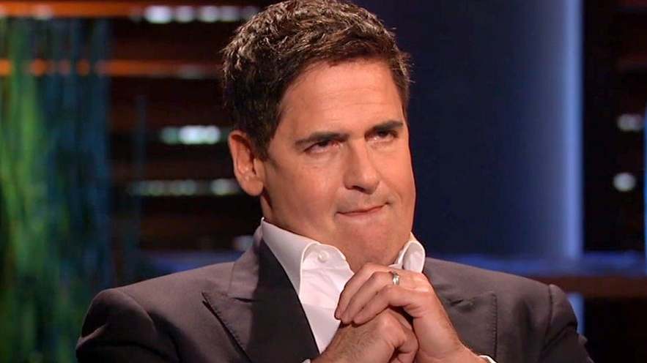
Notes:
What about this picture represents high ECO?

Slide 10
Individualistic
Need
Want
Unrestricted
Independent
Self-Reliant
Creative
Balanced
Cooperative
Accommodating
Supportive
Apprehensive
Secure
The Individualistic Attractor: The Individualistic driver deals with one's need to be seen as autonomous, unique, independent, and to stand apart from the crowd.
This is the drive to be socially independent and have opportunity for freedom of personal expression.
Very High
High
Average
Low
Very low
Notes:
Review Slide: Note animations to reveal definitions behind picture.
Start with scale visual, then click to share definitions
This deals with one’s need to be seen as autonomous, unique, independent, and to stand apart from the crowd.
This is the drive to be socially independent and have opportunity for freedom of personal expressi

Slide 11

Notes:
What about this picture is High Individualistic?

Slide 12
Power
Need
Want
Domineering
Forceful
Authoritarian
Controlling
Directive
Influential
Supportive
Yielding
Passive
Submissive
The Power Attractor: This attractor is about being seen as a leader, and to have influence and control over one's environment or success.
Competitiveness and control is often associated with those scoring high in this motivation.
Very High
High
Average
Low
Very low
Notes:
Review Slide: Note animations to reveal definitions behind picture.
Start with scale visual, then click to share definitions
This is about being seen as a leader, and to have influence and control over one’s environment or success. Competitiveness and control are often associated with a high score in this motivation.

Slide 13

Notes:
What about this picture represents High Power?

Slide 14
Altruistic
Need
Want
Pushover
Sacrificial
Accommodating
Obliging
Supportive
Helpful
Self-Protective
Suspicious
Distrusting
Self-Focused
The Altruistic Attractor: This attractor is an expression of the need, drive or energy to benefit others at the expense of self.
At times there’s genuine sincerity in this dimension to help others, but not always. Oftentimes this is a sign of a low self-worth.
Very High
High
Average
Low
Very low
Notes:
Review Slide: Note animations to reveal definitions behind picture.
Start with scale visual, then click to share definitions
This motivation is an expression of the need or energy to benefit others at the expense of self. At times there is a genuine sincerity to help others, but not always; this can be a sign of low self-worth.

Slide 15
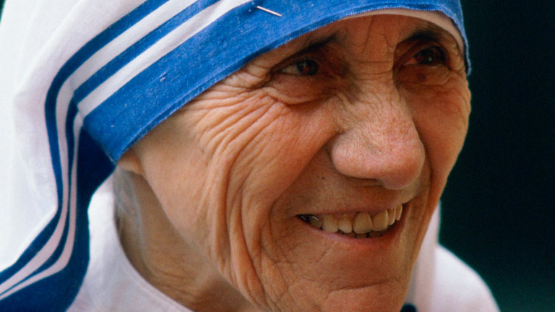
Notes:
What about this picture represents High Altruistic?
Facilitator Note: Many times people will notice that though Mother Theresa is a High Altruistic, she was not a pushover. That is correct. Her Economic and Regulatory scores were higher, so while she self-sacrificed for the good of others, she was not a person who would be taken advantage of and had strong principles. It is sometimes helpful to talk about the difference between Mother Theresa and someone who COULD be a pushover (lower ECO score, and likely a much lower REG score), so the learner further understands why it is so important to review these motivators in combination, rather than just individually. Remember, the Motivators in combination influence one another in different ways.

Slide 16
Regulatory
Need
Want
Black & White
Fixed
Systemic
Orderly
Disciplined
Open-Minded
Flexible
Independent
Spontaneous
Defiant
The Regulatory Attractor: The Regulatory attractor indicates a need and drive to establish order, routine and structure within the outer-world.
This motivation is to promote a black & white mindset and a traditional/reliable approach to problems and challenges through standards, rules, and protocols.
Very High
High
Average
Low
Very low
Notes:
Review Slide: Note animations to reveal definitions behind picture.
Start with scale visual, then click to share definitions
This indicates a need to establish order, routine, and structure. High scores in this motivation promote a black and white mindset and a traditional approach to problems and challenges through standards, rules, and protocols.

Slide 17

Notes:
What about this picture represents High Regulatory?

Slide 18
Theoretical
Need
Want
Scholarly
Fact Finder
Studious
Investigative
Inquisitive
Reflective
Street Smart
Intuitive
Surface Analyzer
Disinterested
The Theoretical Attractor: The desire to uncover, discover, and recover the "truth.” This need to gain knowledge for knowledge sake is the result of an “itchy” brain.
Rational thinking reasoning and problem solving are important to this dimension.
Very High
High
Average
Low
Very low
Notes:
Review Slide: Note animations to reveal definitions behind picture.
Start with scale visual, then click to share definitions
The desire to uncover, discover and recover the truth, this motivation needs to gain knowledge for knowledge sake. They have a need to know. Rational thinking, reasoning, and problem solving are important to those high in this motivation.

Slide 19
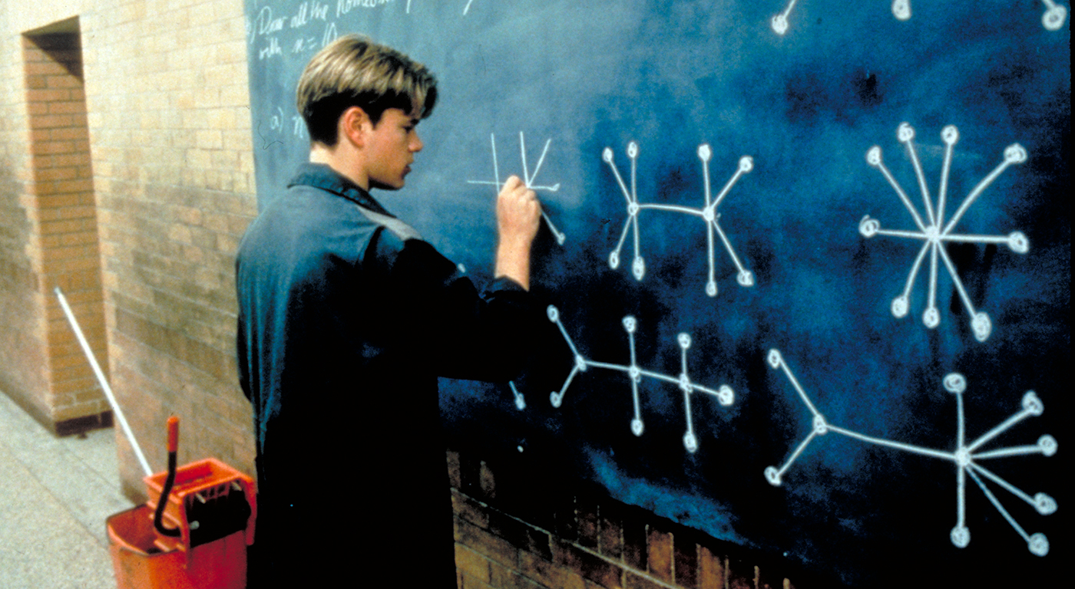
Notes:
What about this picture is High Theoretical?

Slide 20
Different Motivators
Why is it important to know if someone has different motivators than you do?
55%
45%
45%
25%
30%
53%
47%
Notes:
ASK: Why is it important to know if someone has different motivators than you do?
We all see others as we are, not as they are. We all have our own needs and desires, and we all express them differently through our actions.
If we have different Motivators, we make different choices. Motivators are the reasons that drive us to WANT to act.

Slide 21
Individual Motivators are not Enough…
Understanding how EACH Motivator drives behavior and action is important…
AND
Understanding how Motivators work in COMBINATION is important too!
Notes:
Individual Motivators are not enough. To best understand the importance and impact of Motivators, we have to look at how they interact with each other and what the Combination can tell us. Some Motivators support each other bringing more impact and weight to them as they influence decisions and actions. Other times, Motivators can conflict with one another, causing tension or preventing satisfaction as they counteract the importance of something else.
It is important to know how each Motivator works, but for the best understanding and awareness, always review them in combination with one another as well to create a holistic picture of the Motivators.

Slide 22
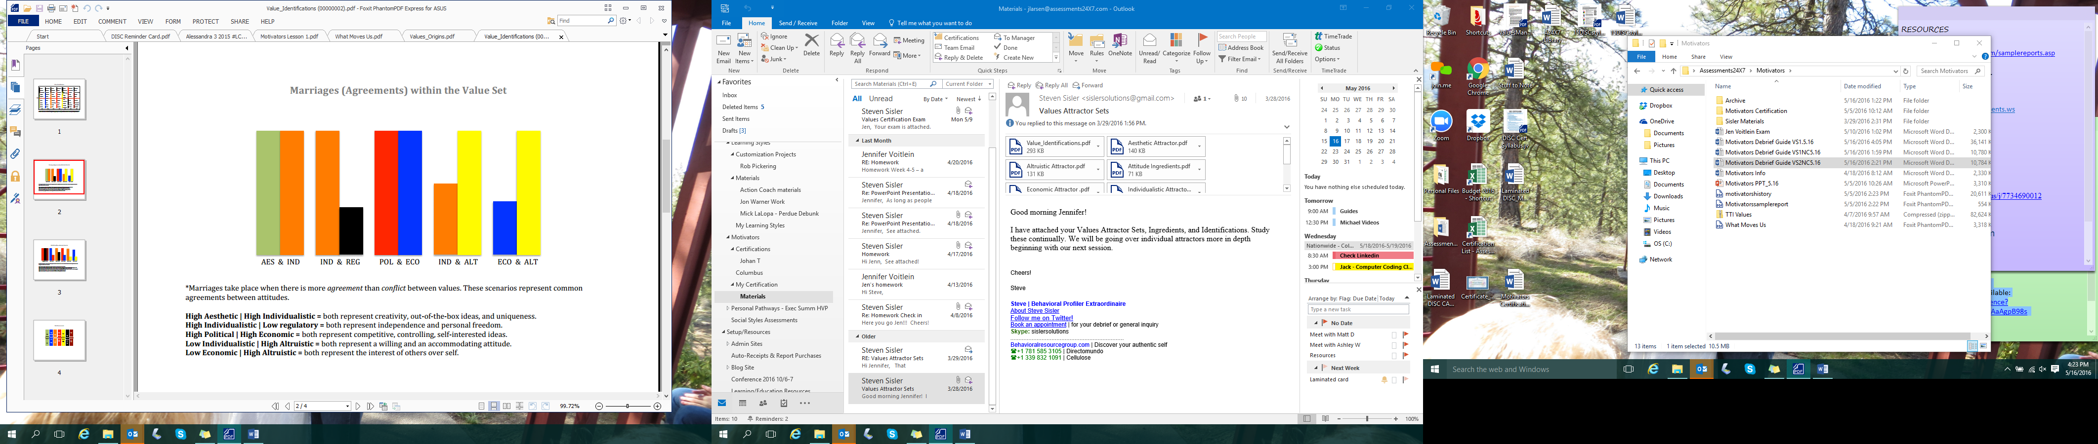
Supporting Values
Some value combinations bring sustainability to the emotional drive, thus strengthening its resolve and lending to a greater impact.
Notes:
Review these combos as examples. They are very common patterns -
High AES, High IND – both represent creativity, out of the box ideas, and uniqueness
High IND, Low REG – both represent independence and personal freedom
High POL, High ECO – both represent competitive, controlling, self-interested ideas
Low IND, High ALT – both represent a willing and accommodating attitude
Low ECO, High ALT – both represent the interest of others over self.

Slide 23
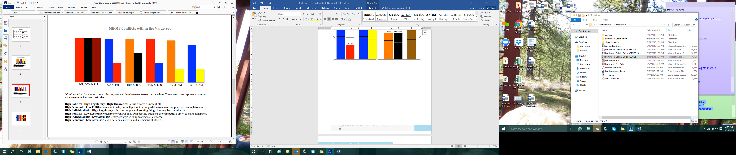
Conflicting Values
Some value combinations bring dissonance to the emotional drive, thus strengthening its resolve in a new way.
Notes:
Review these combos as examples. They are very common patterns -
High ECO, Low POL – wants to win, but will put self in the position not to, or not play hard enough to win
High IND, High REG – desires unique and exciting things, but may be risk averse
High POL, Low ECO – desires to control own destiny, but lacks competitive spirit to make it happen

Slide 24
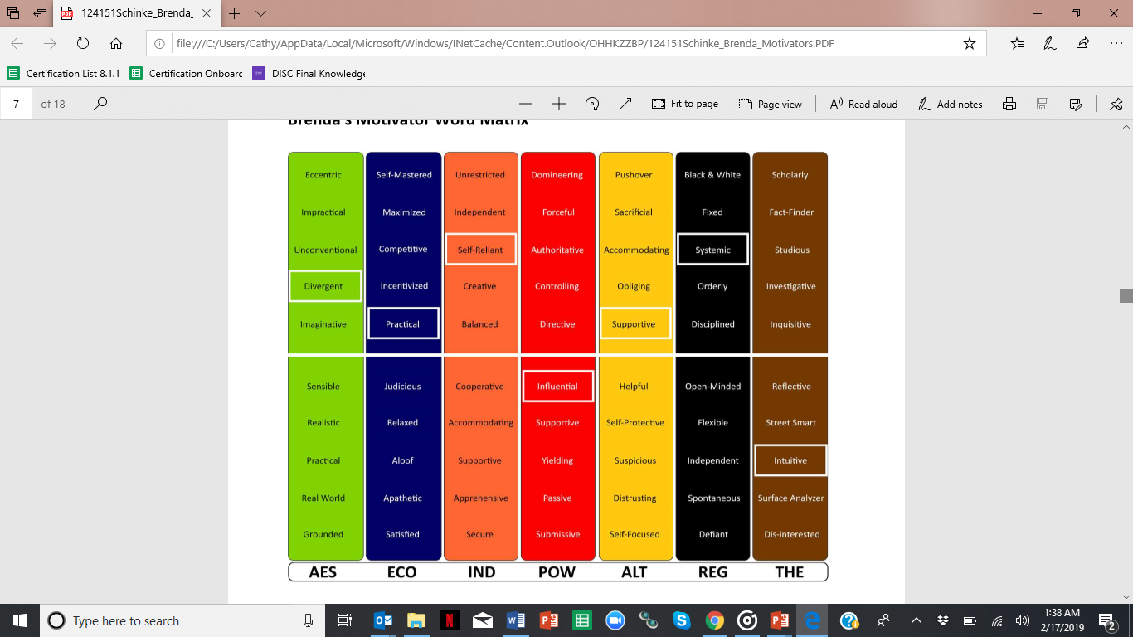
Notes:
In the report, the highlighted words help to create a picture of the motivation drivers of this individual, collectively. With these descriptors, you can also see patterns in descriptors, either where there is support, or where there may be areas of tension of conflict.

Slide 25
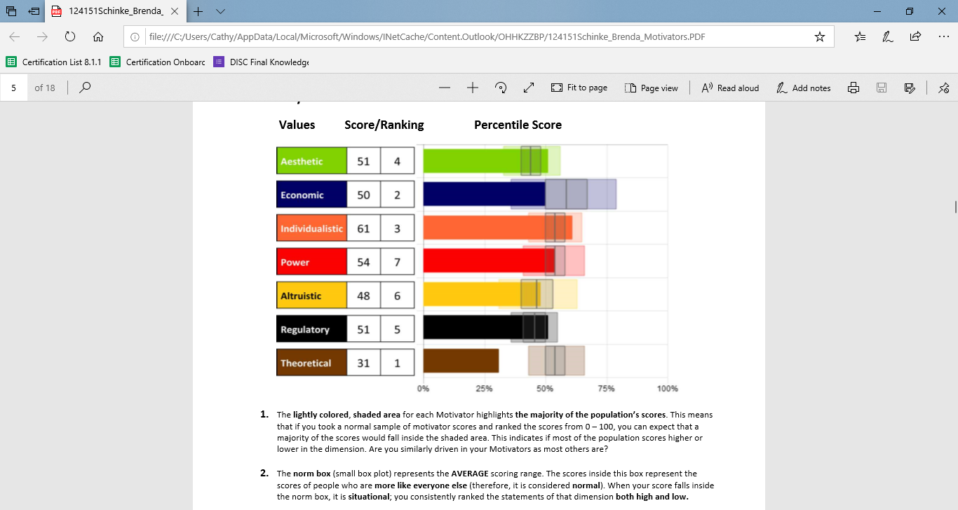
Scoring Motivators
The solid bar & number
The shaded area
The box plot
The norm line
Ranking
Notes:
Review Slide – show each of the 5 steps.

Slide 26
Scoring Motivators
The solid bar & number: Your score in each dimension shown in a bar graph and shows Importance of the dimension
The shaded area: Indicates where 50% of the population scores in each dimension
The box plot: Shows the range that makes up an Average score - – the majority of the 50% in the shaded area fall in this box
The norm line: Shows the MEDIAN score for each dimension
Ranking: Reveals which score as most impactful to your decisions (true ranking)
Notes:
The solid bar & number: Your score in each dimension shown in a bar graph and shows Importance of the dimension
The shaded area: Indicates where 50% of the population scores in each dimension
The box plot: Shows the range that makes up an Average score – the majority of the 50% in the shaded area fall in this box
The norm line: Shows the MEDIAN score for each dimension
Ranking: Reveals which score as most impactful to your decisions (true ranking)

Slide 27
Importance & Impact - Scoring
Importance – IF I value it and HOW I value it (determined by high or low scores):
Score shows how consistently I responded to the words between 2 end points (think of opposites: hot/cold, North/South).
IF I value it - the higher the score the more I value this dimension High – it is more important to me Low – it is less important to me
HOW I value it – the score, whether high or low, shows HOW I will place value. For example, High ECO values a return on investment for self, but LOW ECO values investing for the sake of others with no need for return on investment for self.
Impact – how it influences my decisions and actions (determined by distance from norm - ranking):
Impact is determined by how far it is away from NORMAL. Scores that fall within the Average will have less impact because the needs are without passion, where scores that are higher or lower have more passion for or away from.
If 7 out of 10 people are all doing things the same way, the only person who will be noticed (and also feel out of place) will be the outlier, doing things in a way others haven’t.
Because all people are looking to balance an individual existence with a shared/community existence, being like the population can have a great deal of impact on how we choose to behave.
Notes:
From a scoring perspective, let’s revisit Importance and Impact.
Measuring the importance – comes in 2 parts – IF I value it and HOW I value that motivator (determined by high or low scores):
Importance comes from the number score which is calculated by a bi-axial theory which has been used since the early 1920’s. We measure a person’s reactions to stimulus words and accumulate all of their responses to measure of how consistently they responded to the stimulus words or not. The cumulative effect of summing their answers give measure of consistency of responses between 2 end points (think of opposites: hot/cold, North/South). In this report, a score of 50 marks perfectly balanced between the two poles of High and Low. If you move up in score from 50, you are closer to high, but if you move down from 50, you are closer to low.
Impact – how it influences my decisions and actions (determined by distance from norm – the ranking):
Impact is determined by how far it is away from NORMAL. Scores that fall within the Average will have less impact because the needs are without passion, where scores that are higher or lower have more passion for or away from.
If 7 out of 10 people are all doing things the same way, the only person who will be noticed (and also feel out of place) will be the outlier, doing things in a way others haven't. Because all people are looking to balance an individual existence with a shared/community existence, being like the population can have a great deal of impact on how we choose to behave.
This part of the equation is based on approximately 15 years of study of axiology, behavior and motivators orientations (12 years of research, and 3+ years of creating the profile).

Slide 28
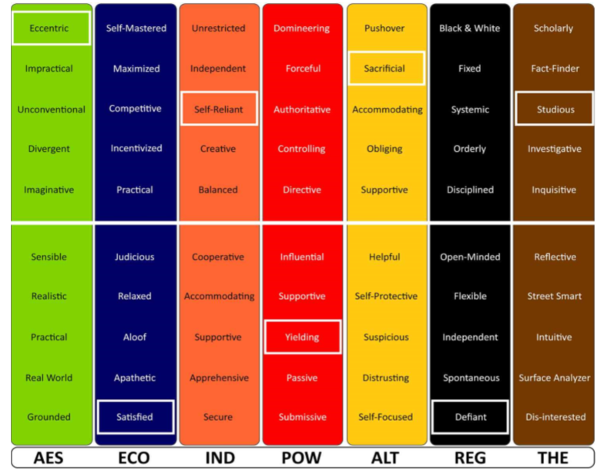
Example: Jill Importance & Impact
Importance If I value it & How I value it
Impact How that influences me
Notes:
This is Jill.
First let’s look at IMPORTANCE.
Which Motivators are most important to Jill? AES, ALT, IND, THE
Which Motivators are least important to Jill? ECO, REG, POW
How does she value each of these Motivators: (Use the word sketch descriptors in highlighted box. Ex. AES is Eccentric) You can use these descriptors to create a picture of Jill. So – she’s Eccentric, Satisfied, Self-Reliant, Yielding, Sacrificial, Defiant, and Studious. What can we see here that is interesting both individually and in combination? Any supporting on conflicting areas? (Review combos: Low ECO/Low POW, Low ECO/High ALT, Low REG/High IND, High AES/High THE)
SO, what does that mean when we look at how Jill is driven in her decisions and actions?
That’s where IMPACT comes in.
Jill is most driven in order by her LOW Economic, then her HIGH Aesthetic, then her LOW Regulatory, next, High Altruistic, Low Power, High Individualistic and finally her High Theoretical. Notice – some of the least impactful are still scored as IMPORTANT.
When we look at the ranking order of impact, we’re looking at what will she take into consideration the MOST when making a decision or taking action. WHILE some of these areas are IMPORTANT to her, they may not be as highly considered as others as she moves forward with behavior.
For example, her LOW economic Motivators ranks as MOST IMPACTFUL. What this means is that Jill will make decisions based on her LOW Economic – the decision or action is focused on the return on investment for others, as she is satisfied and doesn’t need a return. Being highly Economic (what’s in it for me?) is NOT important to Jill. She wants to do for other to ensure they have what they need and desire.

Slide 29
Wants & Needs
Very Low Low Average High Very High *Teens and Below *Above 85
*The very high and very low can be “risk zones” – WANTS turn to NEEDS
Wanting to lead vs. Needing to lead
Wanting to win vs. Needing to win
Notes:
Now, let’s add one more element to this, that can make a difference in the way our Motivators drive us.
There are five score options for Motivators:
Very Low, Low, Average, High, Very High
Both low and high scores can have an influence on the choices we make. Average scores (in the mid-range noted by a grey box plot in the report) create a normal degree of influence which is typically not noticeable.
The very high and very low are "red zones" or danger zones. Whether scores are high or low, the motivators with the furthest distance above or below the mean (or norm - the grey line in the center of the box plot) will be the highest influencers leading to the greatest impact on the decisions being made. The impact will be specific to the score (high means different than low) but the influence will be as powerful whether the score is above the line or below.

Slide 30
Scoring Summary
Whether scores are high or low, the motivators with the furthest distance above or below the Norm will have the highest influence leading to the greatest impact on the decisions being made.
Both low and high scores can have an influence on the choices we make. Average scores (in the mid-range noted by a small box plot) create a normal degree of influence which is typically not noticeable.
The very high and very low can be “risk zones” – wants become needs.
Importance and Impact are both important measurements in Motivators.
Notes:
There are five score options for Motivators:
Very Low, Low, Average, High, Very High
Both low and high scores can have an influence on the choices we make. Average scores (in the mid-range noted by a grey box plot in the report) create a normal degree of influence which is typically not noticeable.
The very high and very low are "red zones" or danger zones. Whether scores are high or low, the motivators with the furthest distance above or below the mean (or norm - the grey line in the center of the box plot) will be the highest influencers leading to the greatest impact on the decisions being made. The impact will be specific to the score (high means different than low) but the influence will be as powerful whether the score is above the line or below.

Slide 31
BREAK

Slide 32
Activity: Connecting to Motivation
For your assigned Motivators, use what you know to determine:
What does satisfaction & dissatisfaction look like for the Motivator?
What happens when our wants/needs are met or not met?

Slide 33
Practice Graphs – What do you notice?
Notes:
What do you notice about this graph?

Slide 34
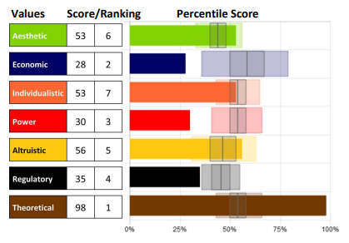
Practice Graphs – What do you notice?
Notes:
What do you notice about this graph?

Slide 35
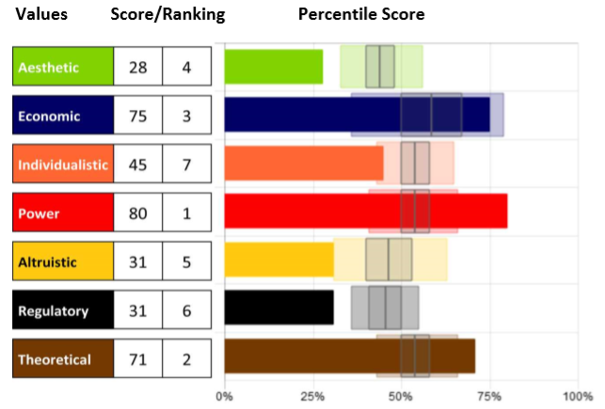
Why is Bill struggling as a manager?
Notes:
What do you notice about this graph?

Slide 36
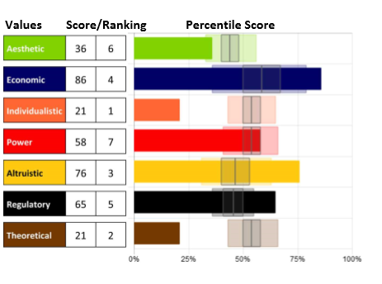
Sue doesn’t know what to major in? Why?
Notes:
What do you notice about this graph?

Slide 37
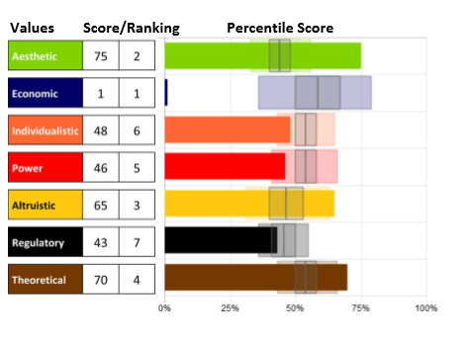
June is upset with her husband. Why?
Notes:
What do you notice about this graph?

Slide 38
Review
What is easy to see in the graphs?
What is difficult to see in the graphs?

Slide 39
Motivators Report Debrief
Notes:
Refer to the Motivators Debrief guide for instruction.

Slide 40
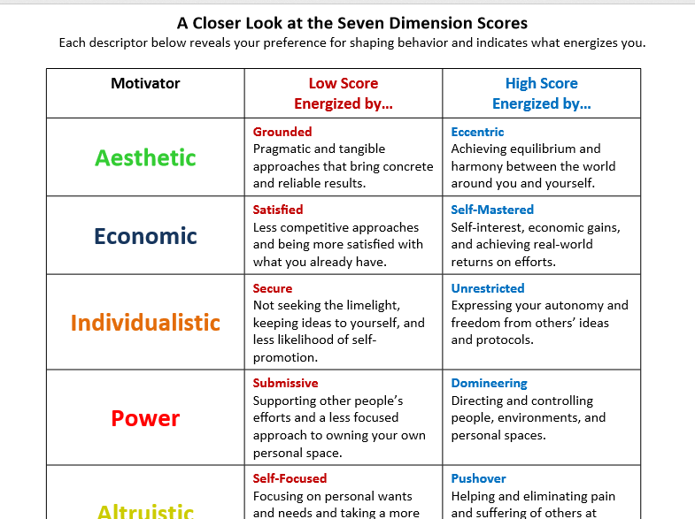
A Closer Look

Slide 41
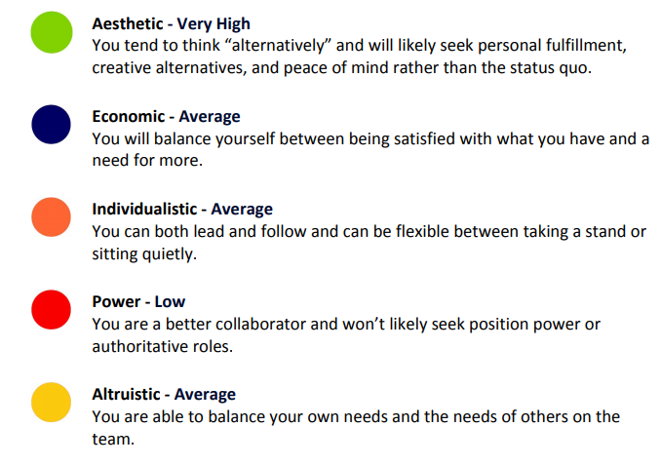
Individual Score & Statements

Slide 42
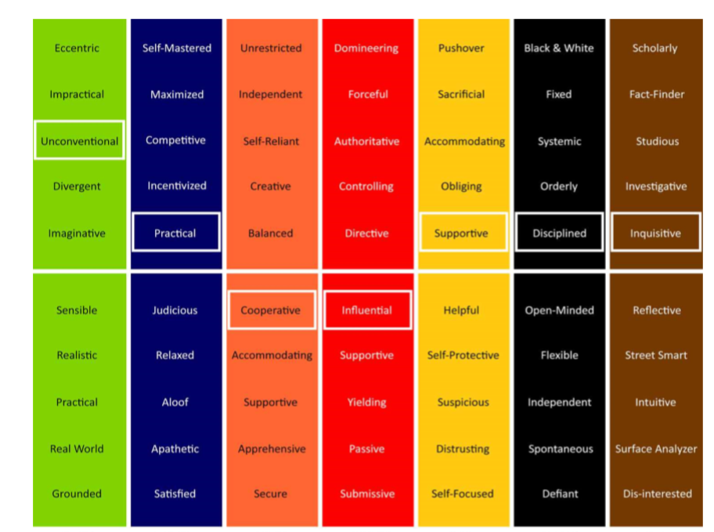
Word Matrix

Slide 43
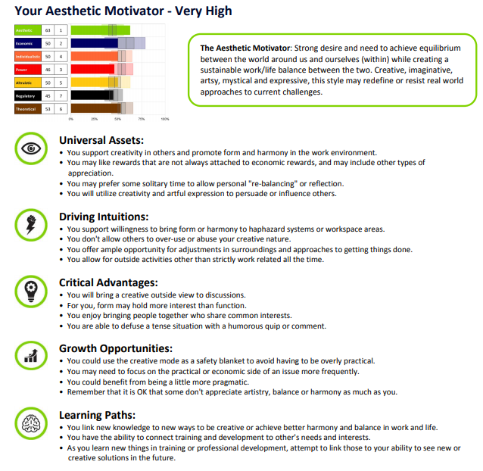
Individual Motivator Pages

Slide 44
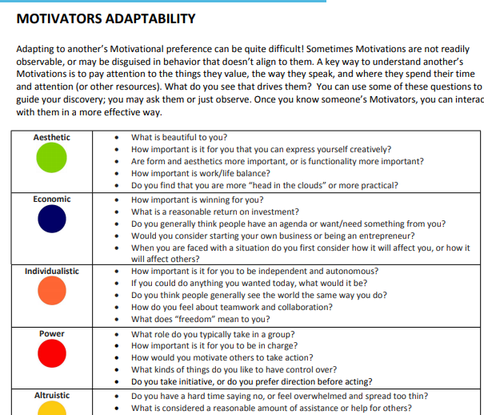
Adaptability

Slide 45
Tiny Steps, Big Results Plan
Reflection and Action:
What works? What does not work?
Where do I excel and what Motivators are engaged?
What Motivators need attention?
What harmful influence can I eliminate?
What positive influence can I act on?

Slide 46
Coaching
Use open-ended and purposeful follow-up questions to uncover opportunities and reveal areas support is needed. Discuss:
What are the primary motivators for this person?
How do those show up? What behaviors link to those drivers?
What awareness do they have about their individual scores?
Are those scores accurate and reflective of their mindset?
How do those motivators and that mindset influence their choices and behaviors?
Are their behaviors reflecting their wants accurately? If not, why not and should something be done to align them closer?

Slide 47

Did You Know?
Worldwide company and in business for over 25 years
Multitude of Assessments
The 5 Core (with multiple focus areas and languages)
Combination, Specialty and Team Reports
Talent Development
360 Profiles
Hiring & Selection, and more!
Offers outstanding, personalized customer service with your dashboard: support@assessments.ws
Subscription plans or additional assessment purchases: sales@assessments247.com

